Slide 1
Notes Checker
By Stephen Halligan , Adam Moen and Edosa Osarenotor

Slide 2
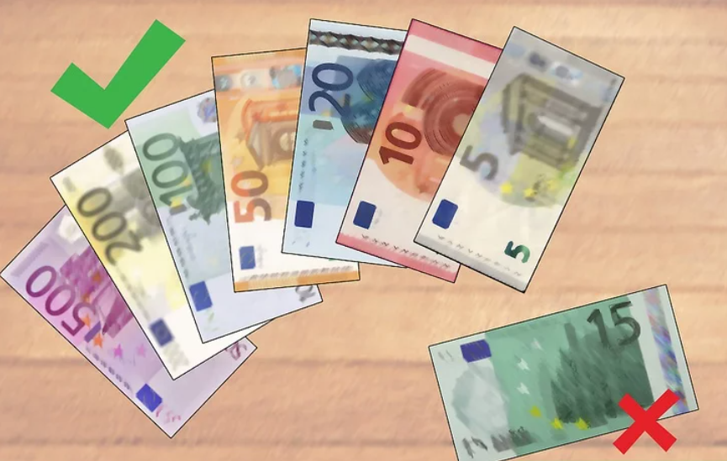
Brainstorming
Emotion / Gesture Identifier
Fake Currency Detection
Notes Checker

Slide 3
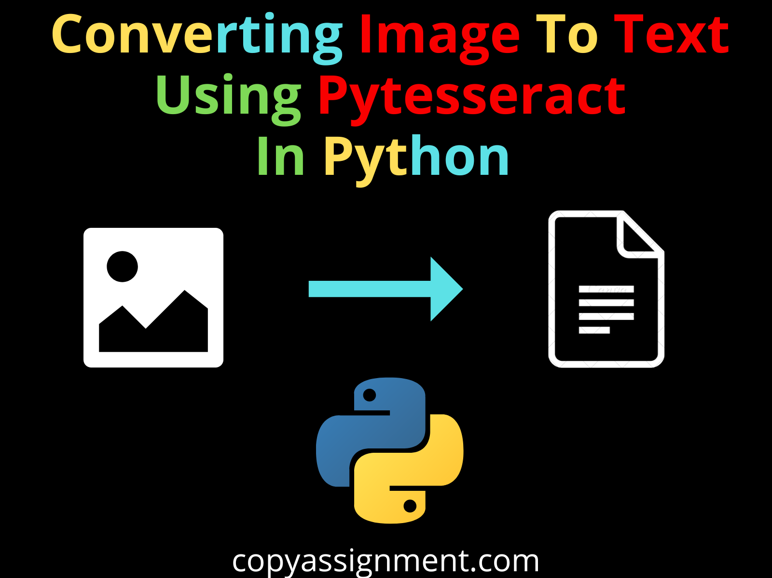
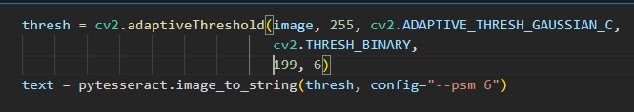
Research
Python-tesseract is an optical character recognition (OCR) tool for python.
That is, it will recognize and “read” the text embedded in images.
Useful for us, as we are extracting information from notes.
Source:
‘Tesseract OCR in Python with Pytesseract & OpenCV’, Nanonets AI & Machine Learning Blog, Aug. 09, 2022. https://nanonets.com/blog/ocr-with-tesseract/ (accessed Nov. 24, 2022).

Slide 4
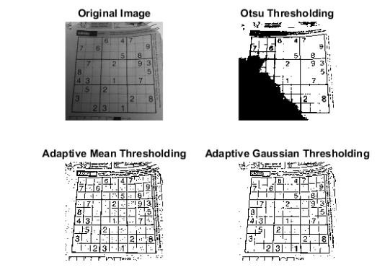
Research
In simple thresholding same threshold value is applied is applied to every pixel.
Adaptive thresholding a local threshold is found for each region of image. Useful for when an image has different lightning throughout it.

Slide 5
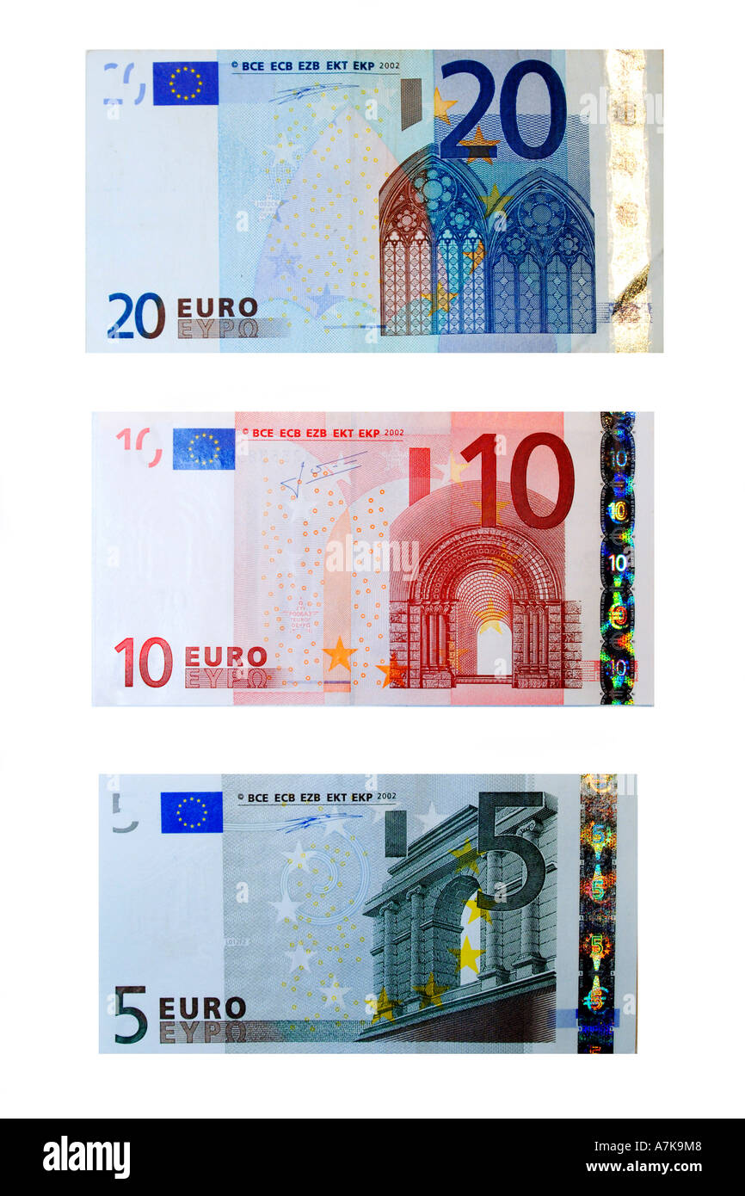
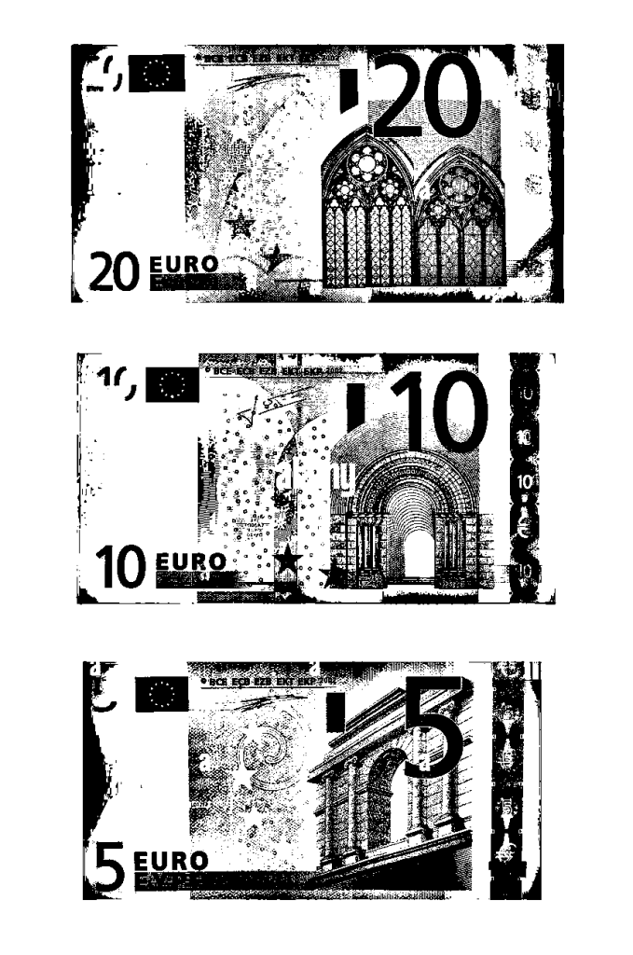
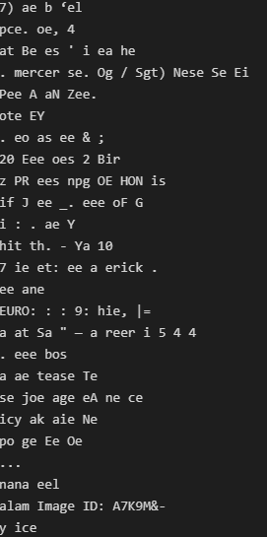
Text Extraction using PyTesseract
Notes:
Explain how we needed to find the right threshold in order to achieve desired outcome

Slide 6
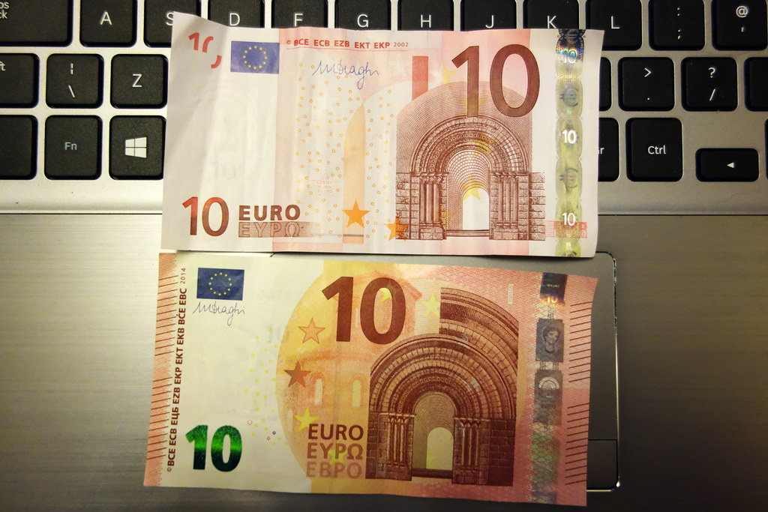
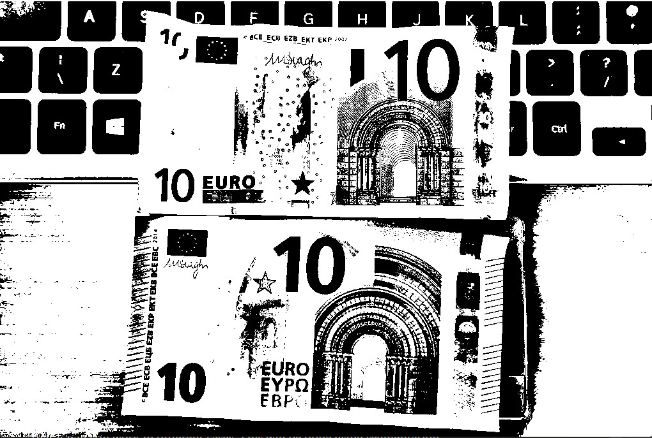
Text Extraction Using PyTesseract

Slide 7
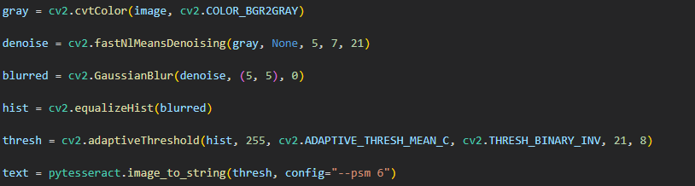
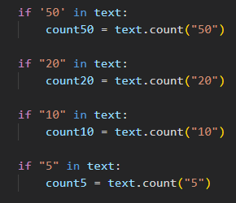
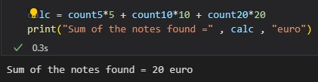
Note Calculation
Notes:
Explain algorithm of how it goes from extracting text to calculation

Slide 8
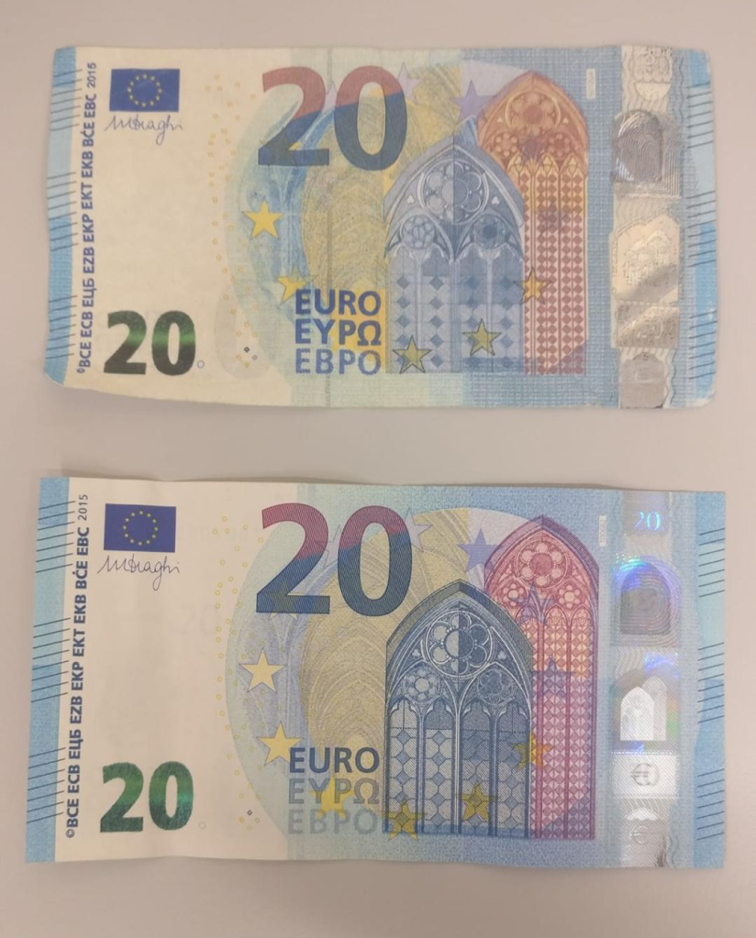
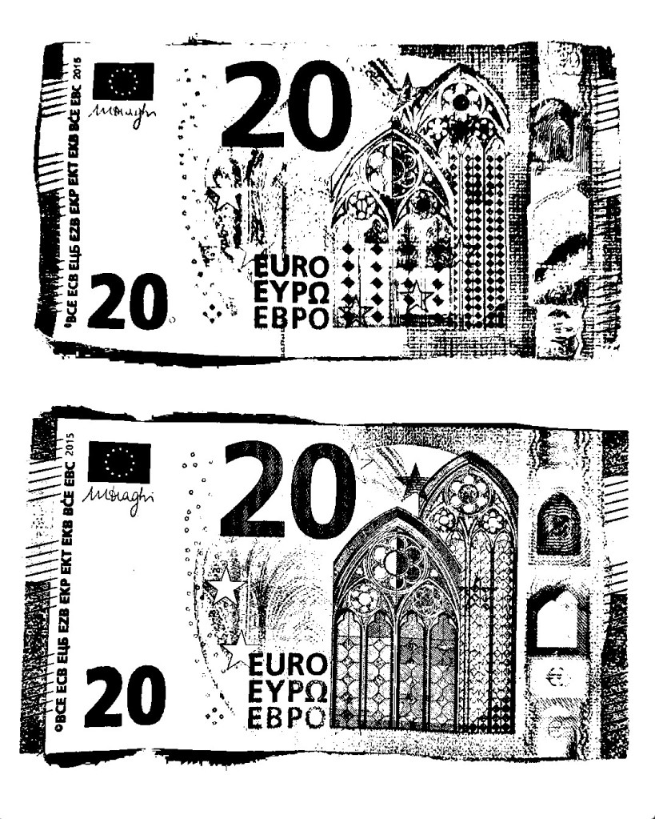
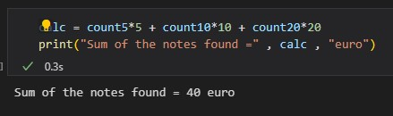
Notes:
Another example with slightly different lighting

Slide 9
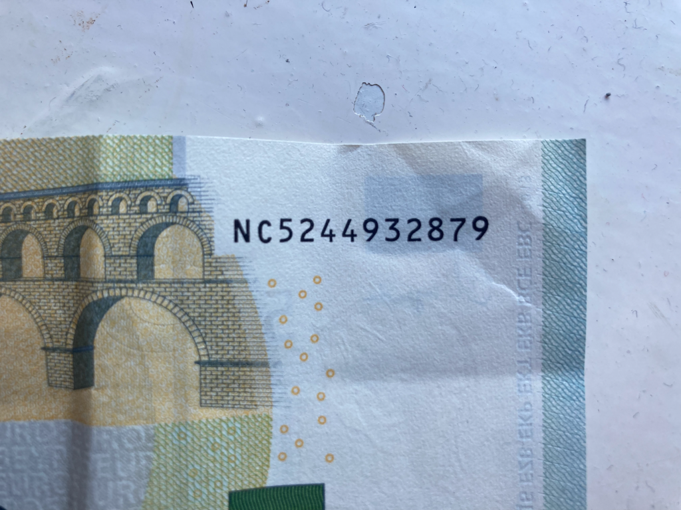
Serial Number Checker
Checksums used within serial numbers to validate the note against the country control
We also use ASCII to convert the 2nd letter to number prior to checksum validation
Country code (first letter of serial number) is also used to validate the authenticity

Slide 10
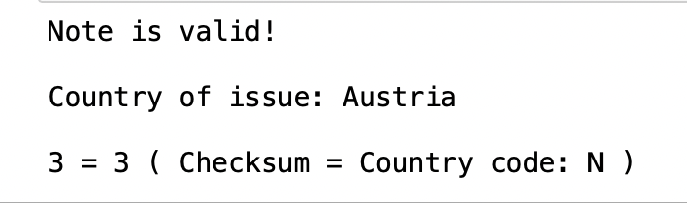
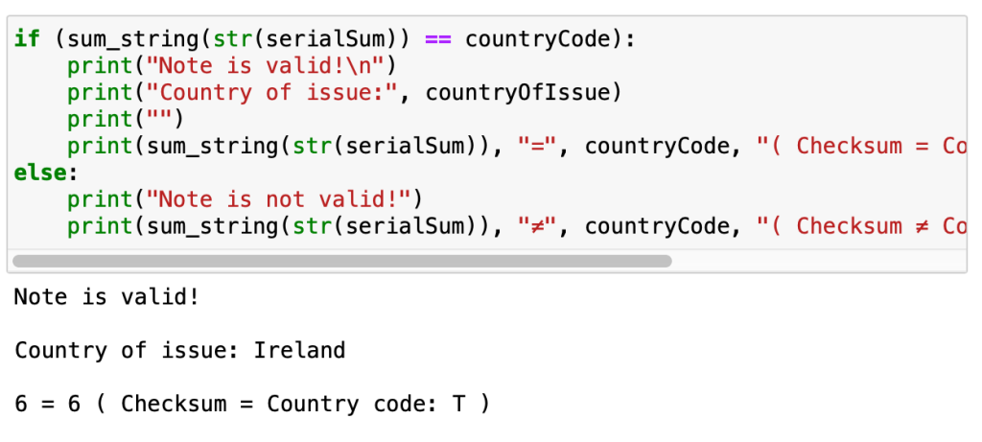
Serial Number Checker Example
Let's take the serial code 'NC5244932879'
To perform calculations on the serial number, we get the ASCII of C, which is 67. Then, we perform a checksum on 67, and 5244932879
This gives us a result of 66. We then apply this to mod9, giving us '3'
Now, we compare 3 to the control code of the serial number, 'N'.
The 'N' control code equates to 3.
As our checksum total and control code number are equal, we can say that the note serial number is validated!

Slide 11
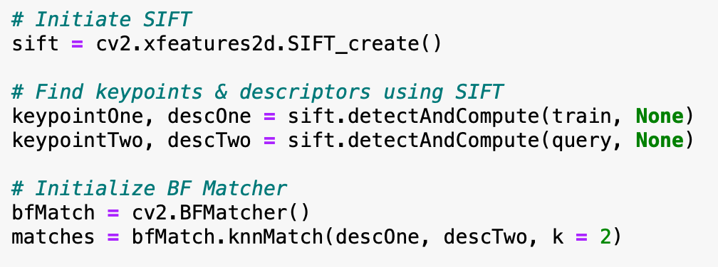
SIFT Image Comparison
SIFT is an algorithm that uses descriptors and key points to compare 2 images against each other
We believe that this would be the most lightweight way to check the validity of a note
For our program, we use SIFT to compare an input banknote to a control image, which is a high-quality photo of a banknote of the same value
Advantages of SIFT
Not affected by scaling
Image brightness doesn't affect output
Not impacted by image rotation

Slide 12
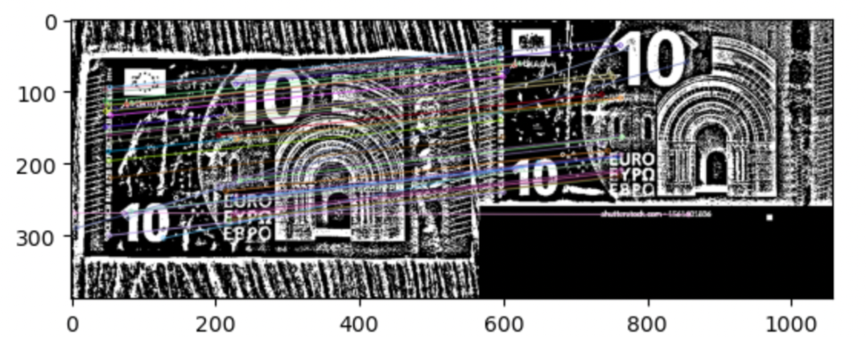
SIFT Image Comparison
When run, we get the following output. As we can see, the images are compared based on they keypoints present in both images!
After a bit of research and some searching through stackoverflow, I found that we can get a comparison of the 2 images based on keypoints.
A key point in this function is the pre-processing of the images in order to apply the SIFT function. To first tell what note is being inputted, we use opencv functions such as blurring, denoising, equalizing histograms

Slide 13
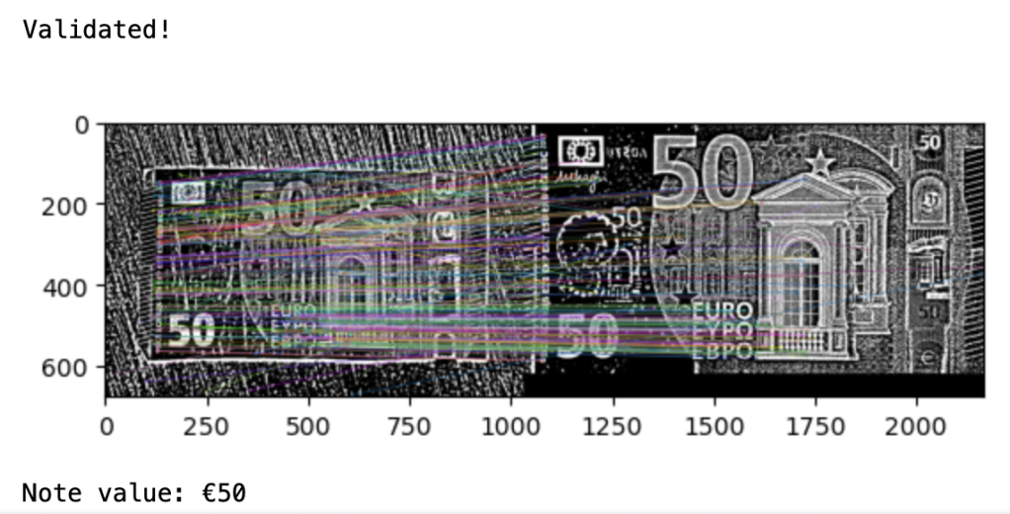
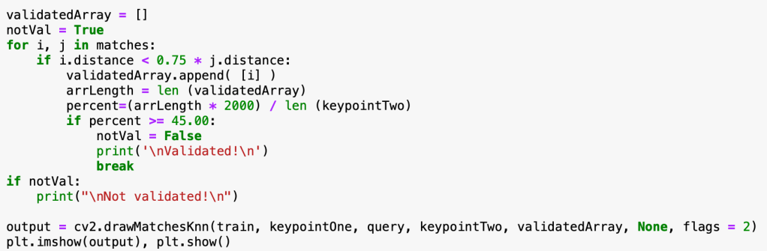
SIFT Comparison Percentages
After a bit of research and some searching through stackoverflow, I found that we can get a comparison of the 2 images based on keypoints.
Seen in the bottom screenshot, if the calculated percentage is greater than 45%, we consider the note to be valid
However, if the percentage is lower than 45%, we consider the note invalid, and can request the user to input a new photo or perform further checks to ensure their note is not counterfeit

Slide 14
Questions?

